Slide 1
ERROR REPORTING
BY: IQRA BALOCH

Slide 2
What is error?
An error is a type of mistake. We can say an error is a condition of having incorrect or false knowledge or an error is defined as an unexpected, invalid program state from which it is impossible to recover.
Error can also be defined as “a deviation from accuracy or correctness”. A “mistake” is an error caused by fault: the fault being misjudgment, carelessness or forgetfulness. An error message with filename, like number and a message describing the error is sent to be the browser.

Slide 3
Types of error
There are 12 unique error types, which can
be grouped into 3 main categories:
Informational (Notices)
Actionable (Warnings)
Fatal (Runtime)

Slide 4
Informational Errors
Harmless problem, non-critical errors that PHP encounters while executing a script. In the notice error execution of the script does not stop.
e.g. use of an undefined variable, defining a string without quotes, Referencing non-existent array keys etc.

Slide 5
Actionable Errors
Indicate that something clearly wrong has happened and that action should be taken.
e.g. file not present, database not available, missing function arguments, etc.

Slide 6
Fatal Errors
Something so terrible has happened during execution of your script that further processing simply cannot continue.
e.g. parsing error, calling an undefined function, require() when the file does not exist etc.

Slide 7
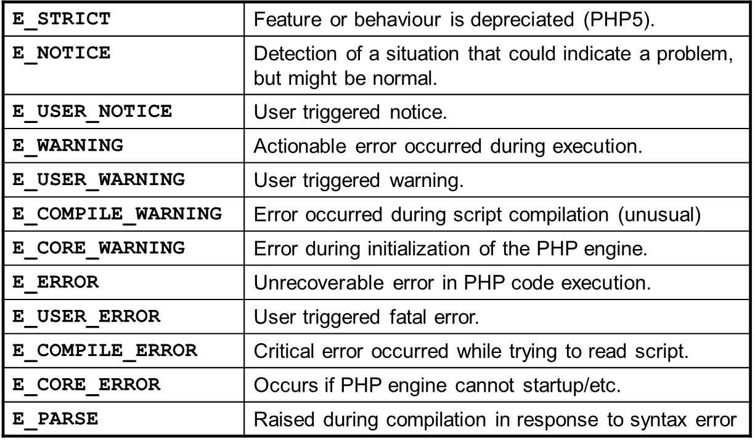
Identifying Errors
notice
warning
fatal

Slide 8
Enabling errors
display_errors = On
error_reporting = ~E_ALL

Slide 9
Customizing Error Handling
Generally, how PHP handles errors is defined by various constants in the installation (php.ini).
There are several things you can control in your scripts however..

Slide 10
1. Set error reporting settings
error_reporting($level)
This function can be used to control which errors are displayed, and which are simply ignored. The effect only lasts for the duration of the execution of your script.

Slide 11
1. Set error reporting settings
<?php
// Turn off all error reporting
error_reporting(0);
// Report simple running errors
error_reporting(E_ERROR | E_WARNING | E_PARSE);
// Reporting E_NOTICE can be good too (to report uninitialized
// variables or catch variable name misspellings ...)
error_reporting(E_ERROR | E_WARNING | E_PARSE | E_NOTICE);
// Report all errors except E_NOTICE
error_reporting(E_ALL ^ E_NOTICE);
// Report ALL PHP errors
error_reporting(E_ALL);
?>

Slide 12
1. Set error reporting settings
Hiding errors is NOT a solution to a problem.
It is useful, however, to hide any errors produced on a live server.
While developing and debugging code, displaying all errors is highly recommended!

Slide 13
2. Suppressing Errors
The special @ operator can be used to suppress function errors.
Any error produced by the function is suppressed and not displayed by PHP regardless of the error reporting setting.

Slide 14
2. Suppressing Errors
Error suppression is NOT a solution to a problem.
It can be useful to locally define your own error handling mechanisms.
If you suppress any errors, you must check for them yourself elsewhere.

Slide 15
3. Custom Error Handler
You can write your own function to handle PHP errors in any way you want.
You simply need to write a function with appropriate inputs, then register it in your script as the error handler.
Function called set_error_handler(), it allows to divert all PHP errors to a custom function that are defined, instead of sending them to the default handler.

Slide 16
3. Custom Error Handler
Custom function must be capable of accepting a minimum of two mandatory arguments:
    Error type
    Message
and up to three additional arguments:
    File name
    Line number
    Context
These arguments are then used to create an error page that is friendlier and more informative than PHP's standard one-line error message

Slide 17
3. Custom Error Handler
function err_handler(
$errcode,$errmsg,$file,$lineno, $context) {
echo ‘An error has occurred!<br />’;
echo “file: $file<br />”;
echo “line: $lineno<br />”;
echo “Problem: $errmsg”;
echo “Variable State: $contexts”;
return true;
}

Slide 18
3. Custom Error Handler
The function then needs to be registered as your custom error handler:
set_error_handler(‘err_handler’);
You can ‘mask’ the custom error handler so it only receives certain types of error. e.g. to register a custom handler just for user triggered errors:
set_error_handler(‘err_handler’,
E_USER_NOTICE | E_USER_WARNING | E_USER_ERROR);

Slide 19
4. Pulling the Trigger
PHP allows you to use its built-in error handling system to raise your own custom errors as well.
This is accomplished via a function named trigger_error(), which allows you to raise any of the three error types reserved for users: E_USER_NOTICE, E_USER_WARNING and E_USER_ERROR.
When these errors are triggered, PHP's built-in handler will automatically wake up to handle them.

Slide 20
4. Pulling the Trigger
$db = @mysql_connect($h,$u,$p);
if (!$db) {
trigger_error(‘blah’,E_USER_ERROR);
}

Slide 21
Review
Various different error types exist in PHP.
The error handling system is highly flexible, and your own error handling methods can be developed.

